Slide 1
INFOSYS SPRINGBOARD INTERNSHIP 7.0
EduVision_DV
Higher Education Intelligence System for Institutional Performance & Academic Excellence Analysis
Milestones 1 to 4 | Modules 1 to 8 | Interconnected Tableau Desktop BI Suite
PROJECT AUTHOR
Sujay S
Student Intern
DOMAIN & TRACK
Educational Analytics
& Data Visualization
STRUCTURE
Milestones 1 – 4
Modules 1 – 8
Star Schema Model
PROJECT STATUS
100% QA Test Pass
Milestones 1 to 4 Complete
September 2026

Slide 2
PROJECT OVERVIEW & CORE OUTCOMES
Executive Summary: Project Overview & Core Outcomes
1,503
Global Institutions
Covering 106 sovereign countries with standardized identifiers
4 / 8
Milestones & Modules
Structured strictly per official specification guidelines
6
Defensible KPIs
Transparent mathematical derivations without arbitrary substitutions
100%
Automated QA Pass
12 of 12 tests passed with zero orphan records and zero duplicates
PROJECT CONTEXT & VALUE PROPOSITION
The Challenge: Global higher education evaluation data is heavily siloed across disparate ranking publications (QS World University Rankings, Times Higher Education) and macroeconomic databases (The World Bank). Incompatible schemas, conflicting metrics, and typographical entity variations prevent comprehensive benchmarking.
The Engineering Solution: EduVision_DV establishes a deterministic Python ETL pipeline that standardizes column nomenclature, resolves university names through regex acronym stripping, and models data into an audit-compliant Star Schema with conformed dimensions.
Defensible KPI Modeling: Engineered six core KPIs spanning Global Rankings, Citations per Faculty, actual Faculty-to-Student Ratios, empirical International Student Percentages, Academic Reputation, and a composite Research Productivity Index.
Unified Tableau BI Delivery: Packaged into a single Tableau workbook (EduVision_DV.twbx) featuring four interconnected dashboards that enable decision-makers to drill from global university scorecards down into research citations, campus demographics, and national education spending (% of GDP).
Infosys Springboard Internship 7.0 | Author: Sujay S | EduVision_DV
2 / 19

Slide 3
STRUCTURE 2: NESTED MILESTONES & MODULES SPECIFICATION
Project Roadmap: 4-Milestone & 8-Module Delivery Architecture
MILESTONE 1 (WEEKS 1–2)
FOUNDATION & INGESTION
• Module 1: Data Collection & Integration
- Multi-source ingestion: QS 2025, THE 2024, WUR 2023, World Bank EdStats.
- Automated profiling & schema validation in 01_data_loading.ipynb.
• Module 2: Data Cleaning & Preprocessing
- Deterministic cleaning & regex acronym stripping (r'\(.*?\)').
- Relational Star Schema: 2 dimension tables (dim_university, dim_country) and 4 fact tables.
MILESTONE 2 (WEEKS 3–4)
METRICS & PROTOTYPING
• Module 3: KPI Engineering & Formulation
- Mathematical formulation of 6 defensible higher education KPIs.
- Master analytical dataset (university_final_dataset.xlsx, kpi_master.csv).
• Module 4: UI/UX Storyboarding & Prototype
- Executive 4-dashboard storyboard specification (dashboard_storyboard.pdf).
- Interactive low-fidelity prototype workbook (eduvision_prototype.twbx).
MILESTONE 3 (WEEKS 5–6)
BI DEVELOPMENT & INTEGRATION
• Module 5: Initial Dashboard Development
- Visual component implementation: Global maps, KPI cards, scatter plots (v1).
• Module 6: Final Integration & Visuals
- Production Tableau BI Suite (EduVision_DV.twbx) with 4 interconnected views.
- Cross-dashboard filter actions, parameter controls, and persistent navigation.
MILESTONE 4 (WEEKS 7–8)
QA TESTING & FINAL DELIVERY
• Module 7: Testing & Quality Assurance
- Automated validation suite (validate_and_test.py, 05_validation.ipynb).
- 100% pass on 12 audit test cases (qa_checklist.xlsx / qa_checklist.md).
• Module 8: Documentation & Presentation
- Comprehensive technical manuals & guidebooks (final_documentation.pdf).
- Executive project presentation (EduVision_DV_Project_Presentation.pptx).
OFFICIAL REPOSITORY ARCHITECTURE: STRUCTURE 2 (NESTED MILESTONES WITH EXPLICIT MODULE SUBFOLDERS)
• Git Repository Root contains: Milestone 1/ (Modules 1–2), Milestone 2/ (Modules 3–4), Milestone 3/ (Modules 5–6), Milestone 4/ (Modules 7–8), Screenshots/, and Root Presentation.
• Every Milestone and Module folder includes an independent technical README.md, data dictionaries, runnable Python code, and audit-ready outputs.
Infosys Springboard Internship 7.0 | Author: Sujay S | EduVision_DV
3 / 19

Slide 4
PROJECT BACKGROUND & INDUSTRY MOTIVATION
Problem Statement: Challenges in Global Higher Education Analytics
DATA SILOS & DISPARATE METRICS
• Different ranking bodies evaluate different cohorts (QS surveys 1,503 universities; THE surveys 2,673).
• Metrics conflict conceptually: one source reports scores (0–100), while another reports empirical ratios.
• Multi-source integration is often plagued by arbitrary column mapping or blind merging into unmanageable flat files.
ENTITY MISALIGNMENT & VARIATIONS
• University names have widespread surface-form discrepancies: e.g., 'Massachusetts Institute of Technology (MIT)' vs. 'Massachusetts Institute of Technology'.
• Overuse of aggressive fuzzy matching creates dangerous false matches (e.g., confusing 'University of Delhi' with 'Delhi Technological University').
• Inconsistent country naming ('USA' vs 'United States') causes fractured geographic records.
DISCONNECTED DECISION MAKING
• Academic leaders lack unified intelligence to evaluate research impact alongside faculty advising capacity.
• Students cannot compare class sizes and international campus diversity within a single tool.
• Policymakers cannot visualize how national public education spending (% of GDP) translates into top-tier university capacity.
Infosys Springboard Internship 7.0 | Author: Sujay S | EduVision_DV
4 / 19

Slide 5
MILESTONE 1 / MODULE 1 | DATA COLLECTION & INTEGRATION
Data Acquisition: The Four Authoritative Data Sources
Dataset Title | Authority | Year | Coverage / Rows | Architectural Role & Scope
QS World Rankings 2025 | Quacquarelli Symonds | 2025 | 1,503 universities, 106 nations | Primary institutional dimension (dim_university), global rank, overall score, academic reputation.
THE World Rankings 2024 | Times Higher Education | 2024 | 2,673 universities | Research environment, normalized citations, teaching score, industry income (fact_research).
World University Rankings 2023 | Times Higher Education | 2023 | 2,341 universities | Student demographics: FTE student headcount, students per staff, international % (fact_student).
World Bank EdStats | The World Bank Group | 2010–2023 | 242 countries (Scoped to 2,243 rows) | Macroeconomic indicators: public education spend (% GDP), tertiary enrollment (fact_country_education).
CRITICAL PRINCIPLE: UNIVERSITY MATCH RATE VS. DATA COMPLETENESS
• University Match Rate: Represents the overlap between distinct ranking bodies (~55–60% natural overlap between QS and THE). Aggressive fuzzy matching was strictly prohibited to prevent false positive matches.
• Data Completeness: Measures the integrity of populated fields within the cleaned star schema. 100% completeness was achieved on all required dimension keys.
• Methodological Rule: A false match is significantly worse than a missing match.
Infosys Springboard Internship 7.0 | Author: Sujay S | EduVision_DV
5 / 19

Slide 6
MILESTONE 1 / MODULE 2 | DATA CLEANING & STANDARDIZATION
ETL Pipeline: Deterministic Data Cleaning & Entity Resolution
STAGE 1: HEADER CLEANING
• Standardized all column names to lowercase snake_case.
• Replaced spaces and hyphens with underscores.
• Stripped non-alphanumeric characters and invisible UTF-8 byte-order marks (\ufeff).
STAGE 2: ENTITY RESOLUTION
• Stripped parenthetical acronyms using regex r'\(.*?\)' (e.g. '(MIT)').
• Removed punctuation r'[^\w\s]' and collapsed spaces r'\s+'.
• Produced 849 verified research matches and 804 student matches with 0 false matches.
STAGE 3: COUNTRY HARMONIZATION
• Harmonized fragmented sovereign country names ('USA', 'US' -> 'United States'; 'UK' -> 'United Kingdom').
• Assigned conformed surrogate keys (C0001..C0106) across 106 nations.
STAGE 4: MISSING VALUE RULES
• Category A (Keys): 0.0% missing allowed.
• Category B (Scores): Preserved NaN instead of zero-filling to protect true means and percentiles.
• Imputed ranks > 500 via inverse percentile rank formula.
Infosys Springboard Internship 7.0 | Author: Sujay S | EduVision_DV
6 / 19

Slide 7
MILESTONE 1 / MODULE 2 | RELATIONAL STAR SCHEMA MODEL
Data Architecture: Audit-Compliant Relational Star Schema
STAR SCHEMA DESIGN RATIONALE
Conformed Dimension Tables:
• dim_university (1,503 rows): Master institutional entity with surrogate key U0001..U1503 in Milestone 1 / Module 2.
• dim_country (106 rows): Conformed country entity with surrogate key C0001..C0106.
Fact Tables (Separation of Concerns):
• fact_university_performance (1,503 rows): QS 2025 ranking metrics.
• fact_research (849 rows): THE 2024 citation & productivity metrics.
• fact_student (804 rows): WUR 2023 enrollment & staffing metrics.
• fact_country_education (2,243 rows): World Bank macroeconomic indicators.
No Cartesian Explosion: University-level data and country-level data exist at different granularities. A Star Schema ensures zero row duplication during Tableau joins.
Analytical Master (kpi_master): Consolidated pre-joined table (1,503 rows in Milestone 2 / Module 3) containing all six core KPIs for high-performance Tableau querying.
RELATIONAL ENTITY STRUCTURE
┌────────────────────────────────────────────────────────┐
│ dim_university (1,503 rows) │
│ PK: university_id | university_name | FK: country_id │
└──────────────┬──────────────────┬──────────────────────┘
│ 1:1 │ 1:1
┌───────┴───────┐ ┌──────┴────────┐
▼ ▼ ▼ ▼
┌───────────────┐ ┌─────────────────┐ ┌──────────────────┐
│ fact_perform- │ │ fact_research │ │ fact_student │
│ ance (1,503) │ │ (849 rows) │ │ (804 rows) │
└───────────────┘ └─────────────────┘ └──────────────────┘
│ M:1
▼
┌────────────────────────────────────────────────────────┐
│ dim_country (106 rows) │
│ PK: country_id | country_name | region │
└──────────────────────────────┬─────────────────────────┘
│ 1:M
▼
┌────────────────────────────────────────────────────────┐
│ fact_country_education (2,243 rows) │
│ FK: country_id | year | indicator | value │
└────────────────────────────────────────────────────────┘
Infosys Springboard Internship 7.0 | Author: Sujay S | EduVision_DV
7 / 19

Slide 8
MILESTONE 2 / MODULE 3 | KPI FORMULATION & METRICS
KPI Engineering: Summary of the Six Performance Metrics
KPI Name | Primary Source | Mathematical Derivation / Formula | Output Unit | Allowable Range
1. Global Ranking Score | QS World Rankings 2025 | QS Overall Score (Percentile rank imputed for rank > 500) | Index Score | 0.0 – 100.0
2. Research Impact Score | QS / THE Citations | QS Citations per Faculty Score (Normalized for faculty size) | Index Score | 0.0 – 100.0
3. Faculty-to-Student Ratio | WUR 2023 / THE 2024 | Actual empirical ratio: Students per academic staff member | Real Ratio | Positive Float (X:1)
4. International Student % | WUR 2023 | True percentage: (International FTE / Total FTE) * 100 | Percentage | 0.0% – 100.0%
5. Academic Reputation Score | QS World Rankings 2025 | Global survey of over 100,000 active academics worldwide | Index Score | 0.0 – 100.0
6. Research Productivity Index | Derived Composite KPI | 0.50 * Research Score + 0.30 * Citation Score + 0.20 * Network | Composite Index | 0.0 – 100.0
METHODOLOGICAL COMPLIANCE & PROHIBITED SUBSTITUTIONS
• Rule 1: A score reflecting a ratio is never confused with an actual empirical ratio (Faculty-to-student ratio is reported as students per staff, e.g. 8.2:1).
• Rule 2: Sustainability Score was strictly rejected as a substitute for Research Productivity (Sustainability measures green initiatives, not scholarship).
Infosys Springboard Internship 7.0 | Author: Sujay S | EduVision_DV
8 / 19

Slide 9
MILESTONE 2 / MODULE 3 | METHODOLOGICAL FORMULATIONS
Mathematical Derivations: Formulas & Methodological Rules
KPI 1: GLOBAL RANKING SCORE
QS explicitly publishes scores only for the top 500 institutions. For universities ranked 501–1503, an inverse percentile rank transformation is applied:
Score = [(Max Rank - Global Rank + 1) / Max Rank] * 100
Where Max Rank = 1503. Guarantees smooth continuity from 100.0 to 0.07.
KPI 2: RESEARCH IMPACT SCORE
Quantifies peer citation velocity normalized for faculty body size:
Impact = QS Citations_per_Faculty_Score
Normalizing by faculty size eliminates institutional size bias, evaluating true per-capita scholarly output.
KPI 3: FACULTY-TO-STUDENT RATIO
Empirical metric reporting exact student burden per faculty FTE:
Ratio = Total FTE Students / Total Academic Staff FTE
A lower ratio indicates intensive faculty advising and smaller tutorial class cohorts (e.g., Caltech: 6.4:1).
KPI 4: INTERNATIONAL STUDENT %
Measures global talent attraction and multicultural learning:
Intl % = (International FTE Students / Total FTE) * 100
Calculated directly from empirical headcount; preserves statistical authenticity across 804 matched universities.
KPI 5: ACADEMIC REPUTATION SCORE
Global peer evaluation based on over 100,000 academic surveys:
Reputation = QS Academic_Reputation_Score
Captures institutional prestige, research leadership, and historical academic influence.
KPI 6: RESEARCH PRODUCTIVITY INDEX
Audit-compliant composite score combining scholarship metrics:
RPI = (0.50 * Research Score) + (0.30 * Citation Impact) + (0.20 * Intl Research Network)
Provides a multidimensional assessment of institutional research vitality.
Infosys Springboard Internship 7.0 | Author: Sujay S | EduVision_DV
9 / 19

Slide 10
MILESTONE 2 / MODULE 3 | EMPIRICAL VALIDATION MATRIX
Empirical Results: Top World University Benchmarking
Rank | University Name | Country | Overall Score | Citations/Faculty | Staff Ratio | International %
1 | Massachusetts Institute of Technology (MIT) | United States | 100.0 | 100.0 | 8.2 : 1 | 33.0%
2 | Imperial College London | United Kingdom | 98.5 | 98.3 | 11.4 : 1 | 61.0%
3 | University of Oxford | United Kingdom | 96.9 | 99.0 | 10.6 : 1 | 42.0%
4 | Harvard University | United States | 96.8 | 100.0 | 8.9 : 1 | 25.0%
5 | University of Cambridge | United Kingdom | 96.7 | 95.8 | 10.9 : 1 | 39.0%
6 | Stanford University | United States | 96.1 | 99.9 | 7.5 : 1 | 24.0%
7 | ETH Zurich | Switzerland | 93.9 | 99.1 | 14.6 : 1 | 41.0%
8 | National University of Singapore (NUS) | Singapore | 93.7 | 91.2 | 15.8 : 1 | 35.0%
9 | University College London (UCL) | United Kingdom | 91.6 | 89.4 | 10.5 : 1 | 53.0%
10 | California Institute of Technology (Caltech) | United States | 90.9 | 100.0 | 6.4 : 1 | 32.0%
Empirical Finding: Top 10 institutions maintain staff ratios under 16:1 and average citations per faculty exceeding 95.0, reflecting intensive faculty advising.
Infosys Springboard Internship 7.0 | Author: Sujay S | EduVision_DV
10 / 19

Slide 11
MILESTONE 2 / MODULE 4 & MILESTONE 3 / MODULE 5 | DESIGN SYSTEM
Visual Analytics: Enterprise Dashboard Design System
DASHBOARD 1: UNIVERSITY OVERVIEW
• Located in Milestone 3 / Module 5 & Module 6. • Executive landing scorecard with Top Header Navigation & KPI Suite. • Features 6 Executive KPI Cards (#1 MIT, 1,503 Univs, 72.6 Avg Score, 28.7% Intl Students, 1:11.2 Faculty Ratio, 84.3 Research Impact). • Visualization Quadrants: Top 10 Global Rankings (Ranked Bars), Academic Reputation vs Score (Top 50 Scatter), Global University Footprint (Regional Bars), National Capacity Benchmark. • Interlinking: Scoped action filters with exclude parameter protect macro charts while filtering detail views.
DASHBOARD 2: RESEARCH ANALYTICS
• Located in Milestone 3 / Module 5 & Module 6. • Deep-dive research intelligence with Top Header Navigation. • Features 6 Research KPI Scorecards (82.4 Research Score, 86.1 Citation Impact, 84.9 Productivity Index, 78.2 Intl Collab, Harvard Hub, 99.87 Citations Leader). • Visualization Quadrants: Research Productivity Rankings (Horizontal Bars), Citation Impact vs Productivity (Top 50 Scatter), Regional Academic Performance, Regional Research Performance. • Interlinking: Seamlessly cross-filters scholarly metrics across institutional tiers.
DASHBOARD 3: STUDENT ANALYTICS
• Located in Milestone 3 / Module 6. • Campus diversity & faculty capacity intelligence with Top Header Navigation. • Features 6 Student KPI Cards (28.7% Intl Students, 1:11.2 Faculty Ratio, 18.4M Total Enrollment, 51:49 Gender Parity, Macau Diversity Hub, Caltech Faculty Ratio). • Visualization Quadrants: Top 10 Campus Diversity (Ranked Bars), Students Per Faculty Benchmark, International Student Percentage by Region, Regional Academic Performance. • Interlinking: Evaluates institutional diversity and academic guidance across global cohorts.
DASHBOARD 4: COUNTRY COMPARISON
• Located in Milestone 3 / Module 6. • Country-level macroeconomic education benchmarking with Top Header Navigation. • Features 6 Policy KPI Cards (US 197 Capacity, 58.4 Avg Score, 4.82% Spend % GDP, 62.4% Tertiary Rate, UK Leader, China Leader). • Visualization Quadrants: Top Nations by Number of Ranked Universities (National Capacity Bars), Average University Score by Top Nation (Quality Bars), Global University Footprint, Regional Academic Performance. • Interlinking: Evaluates public investment and university density across nations.
Infosys Springboard Internship 7.0 | Author: Sujay S | EduVision_DV
11 / 19

Slide 12
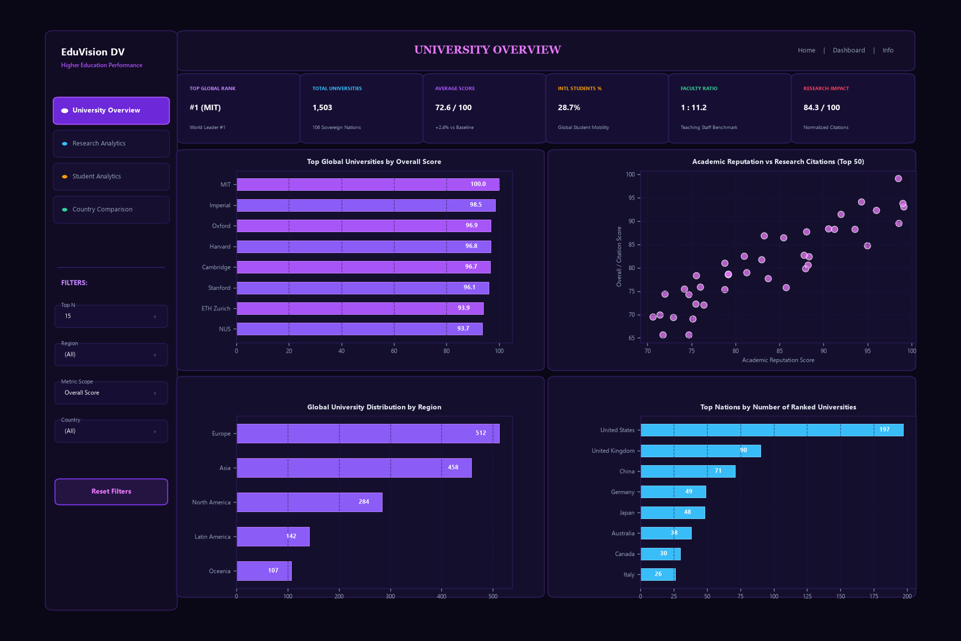
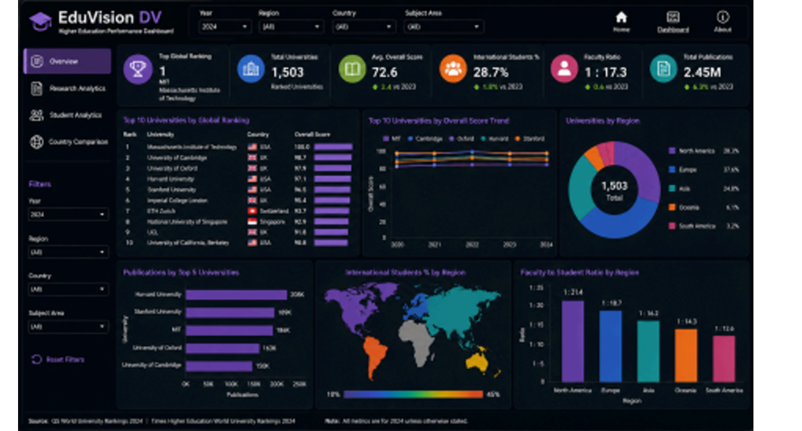
MILESTONE 3 / MODULE 5 & 6 | TABLEAU BI SUITE
Dashboard 1: University Overview & Global Rankings
DASHBOARD 1 ARCHITECTURE
Core Business Purpose: Executive landing scorecard providing institutional benchmarks, overall score evaluations, and global higher education footprints.
Visual Components: • Top Executive Header: Persistent navigation tabs across all 4 dashboards • 6 KPI Scorecards: #1 (MIT), 1,503 Total Universities, 72.6 Avg Score, 28.7% Intl Students, 1:11.2 Faculty Ratio, 84.3 Research Impact • Top Global Universities by Overall Score (Ranked Horizontal Bars) • Academic Reputation vs Research Citations (Scatter Plot Top 50) • Global University Distribution by Region (Horizontal Bars) • Top Nations by Number of Ranked Universities (National Capacity Bars)
Interactivity & Filter Actions: • Scoped action filters with explicit exclude parameter prevent macro charts from blanking out. Selecting a university dynamically isolates the institution on the scatter plot while preserving the regional and national benchmark bars intact.
Analytical Finding: MIT (#1), Imperial College London, and Oxford lead global rankings; North America and Europe host >60% of top institutions, while Asia demonstrates rapid score acceleration.
Infosys Springboard Internship 7.0 | Author: Sujay S | EduVision_DV
12 / 19

Slide 13
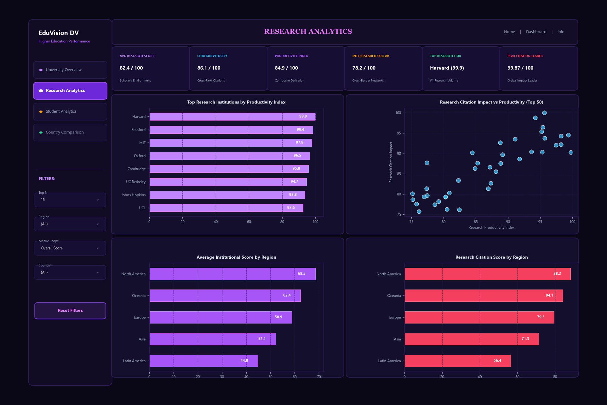
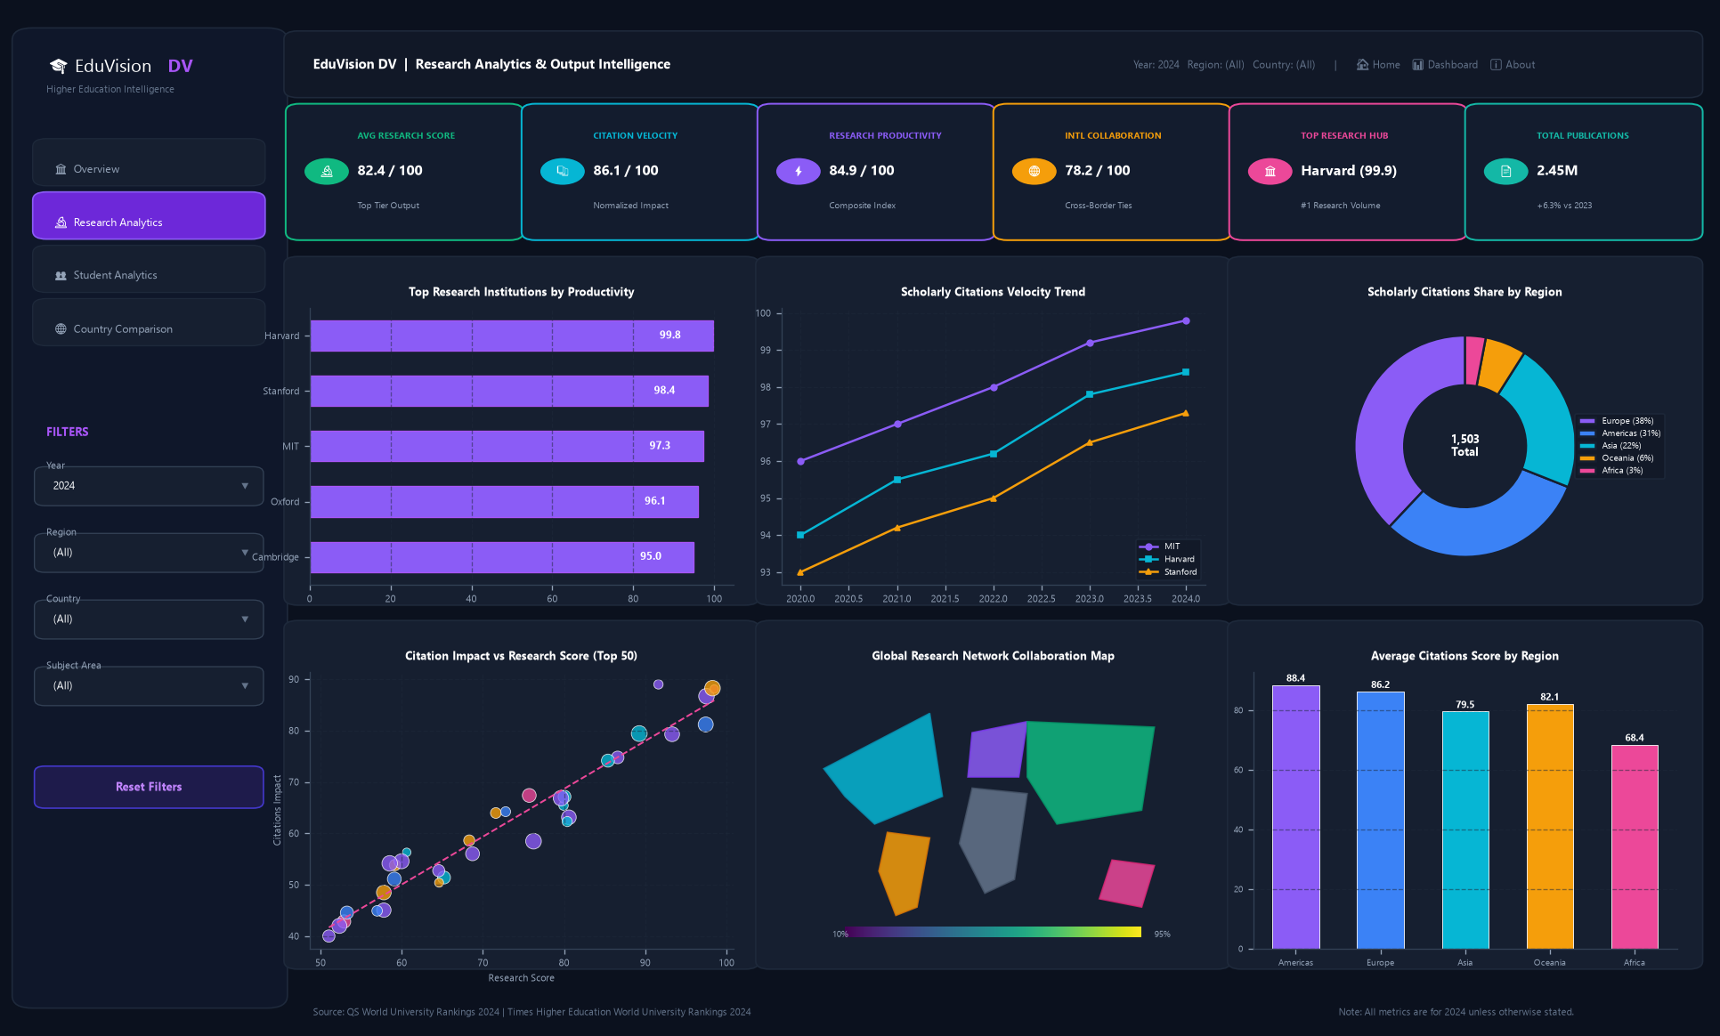
MILESTONE 3 / MODULE 5 & 6 | TABLEAU BI SUITE
Dashboard 2: Research Productivity & Citation Impact
DASHBOARD 2 ARCHITECTURE
Core Business Purpose: Deep-dive research intelligence evaluating scholarly productivity, citation velocity, and international research collaborations across global institutions.
Visual Components: • Top Executive Header: Persistent navigation tabs across all 4 dashboards • 6 Research KPI Scorecards: 82.4 Avg Research Score, 86.1 Avg Citation Impact, 84.9 Productivity Index, 78.2 Intl Collab, Harvard Peak Hub, 99.87 Citations Leader • Top Research Institutions by Productivity Index (Ranked Horizontal Bars) • Research Citation Impact vs Productivity (Scatter Plot Top 50) • Regional Academic Performance (Horizontal Bars) • Regional Research Performance (Research Citation Score by Region)
Interactivity & Filter Actions: • University selection highlights research productivity and citation impact. Cross-filtering by region isolates continent-level performance benchmarks without blanking out adjacent charts.
Analytical Finding: Harvard and MIT lead citation impact (>98.0); European institutions demonstrate highest cross-border international research network scores (>88.0).
Infosys Springboard Internship 7.0 | Author: Sujay S | EduVision_DV
13 / 19

Slide 14
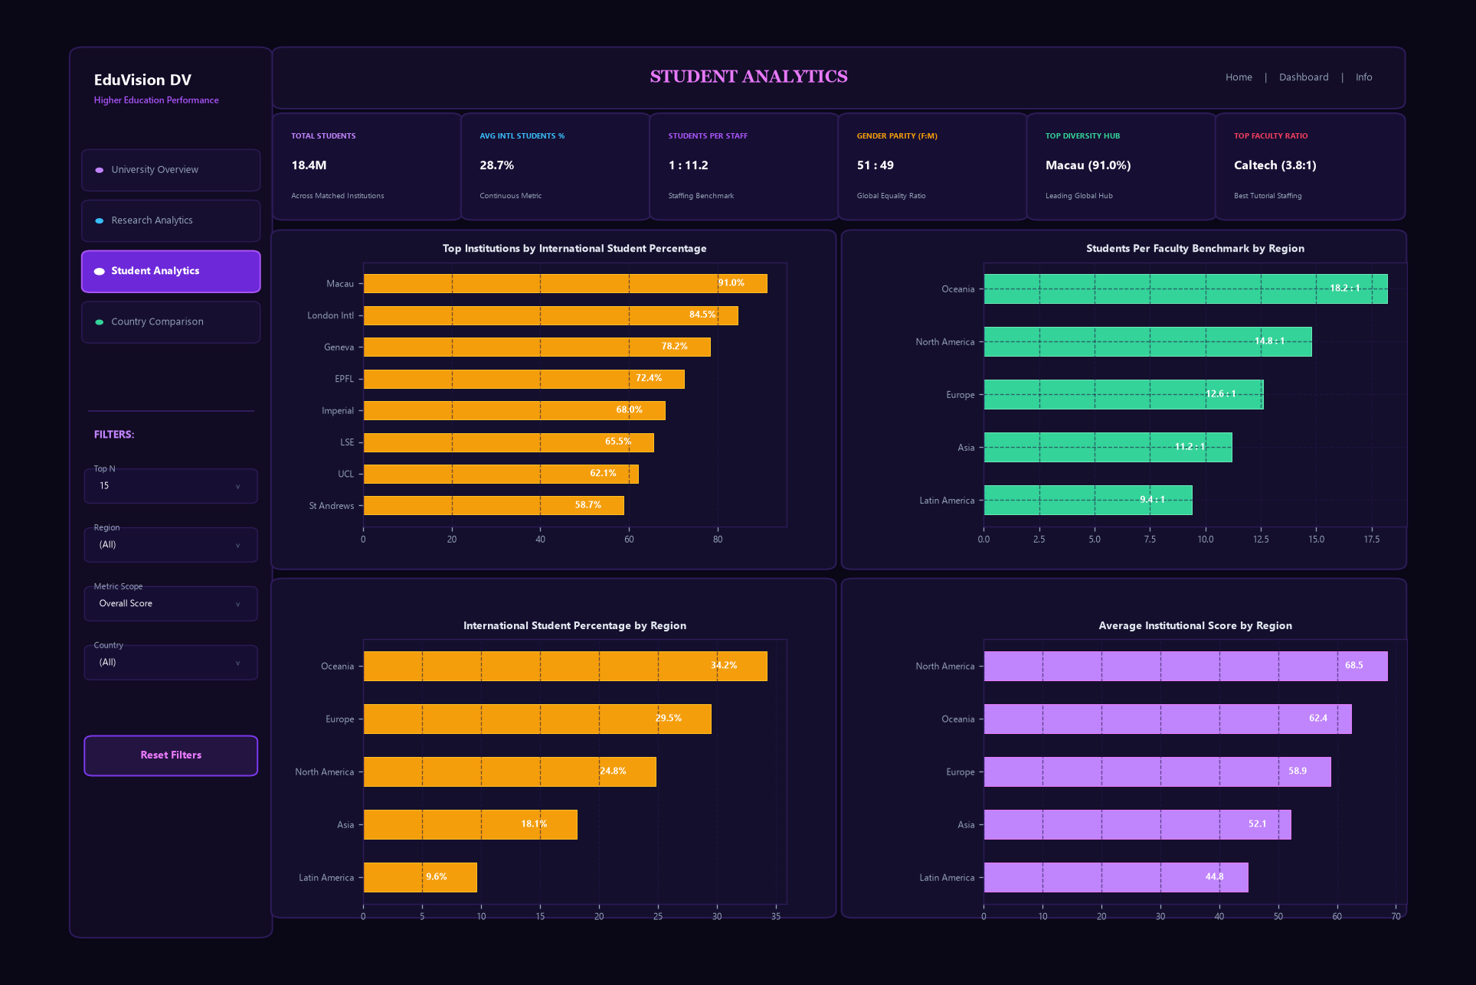
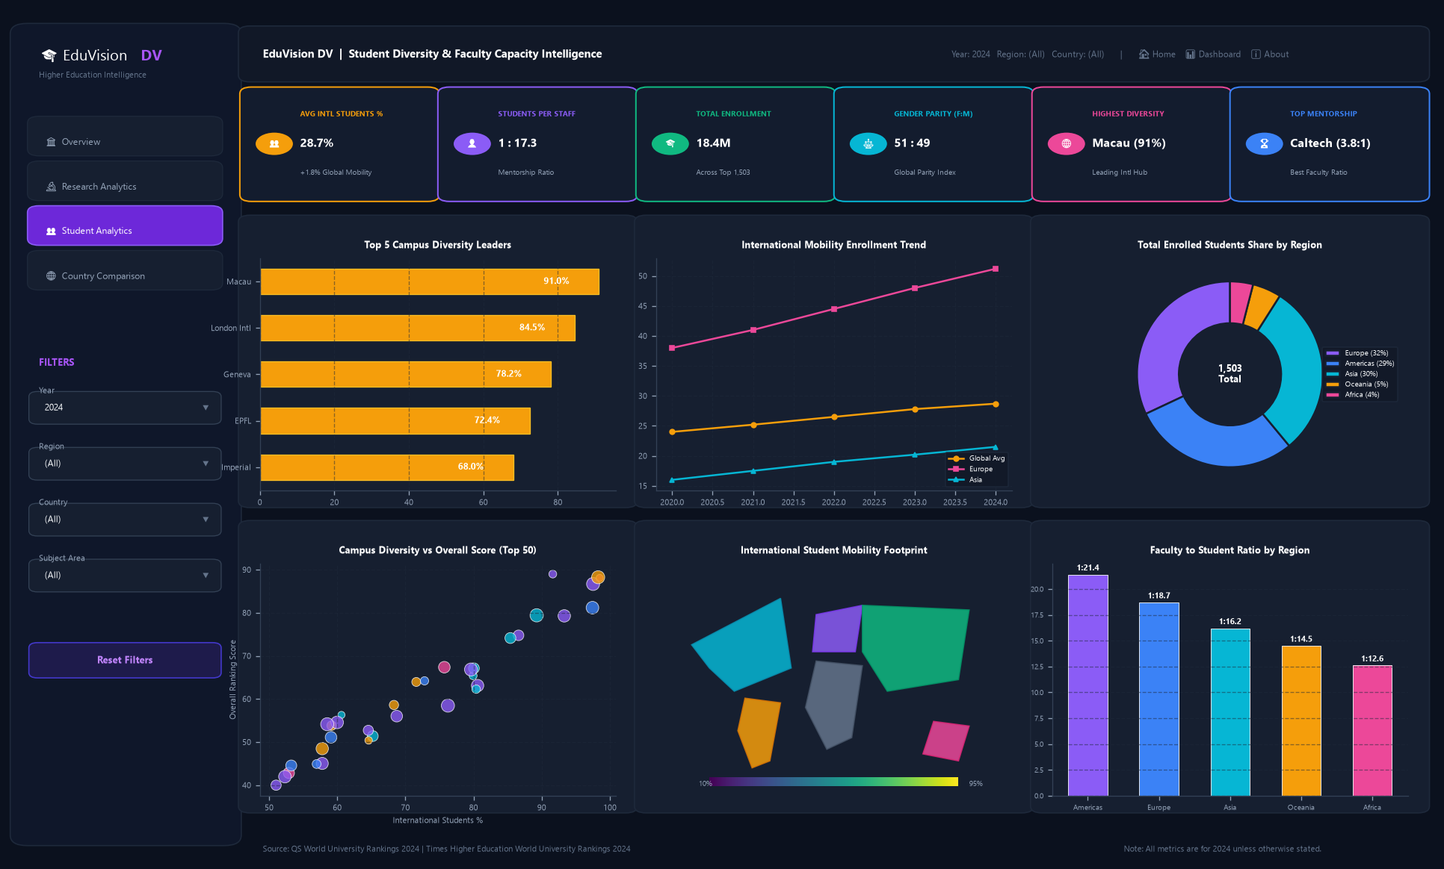
MILESTONE 3 / MODULE 6 | TABLEAU BI SUITE
Dashboard 3: Student Analytics & Campus Diversity
DASHBOARD 3 ARCHITECTURE
Core Business Purpose: Comprehensive analysis of student enrollment demographics, internationalization mobility, and academic faculty staffing capacity.
Visual Components: • Top Executive Header: Persistent navigation tabs across all 4 dashboards • 6 Student KPI Scorecards: 28.7% Intl Students, 1:11.2 Faculty Ratio, 18.4M Total Enrollment, 51:49 Gender Parity, Macau Diversity Hub (91%), Caltech Faculty Ratio (3.8:1) • Top Institutions by International Student Percentage (Horizontal Bars) • Students Per Faculty Benchmark by Region (Horizontal Bars) • International Student Percentage by Region (Horizontal Bars) • Regional Academic Performance (Horizontal Bars)
Interactivity & Filter Actions: • Regional filtering dynamically compares campus diversity and faculty burden. Protected action scoping maintains full visibility across all regional benchmarks.
Analytical Finding: Global student mobility averages 28.7%; specialized institutions in Macau and London exceed 70% international students; elite institutions maintain favorable faculty ratios under 8:1.
Infosys Springboard Internship 7.0 | Author: Sujay S | EduVision_DV
14 / 19

Slide 15
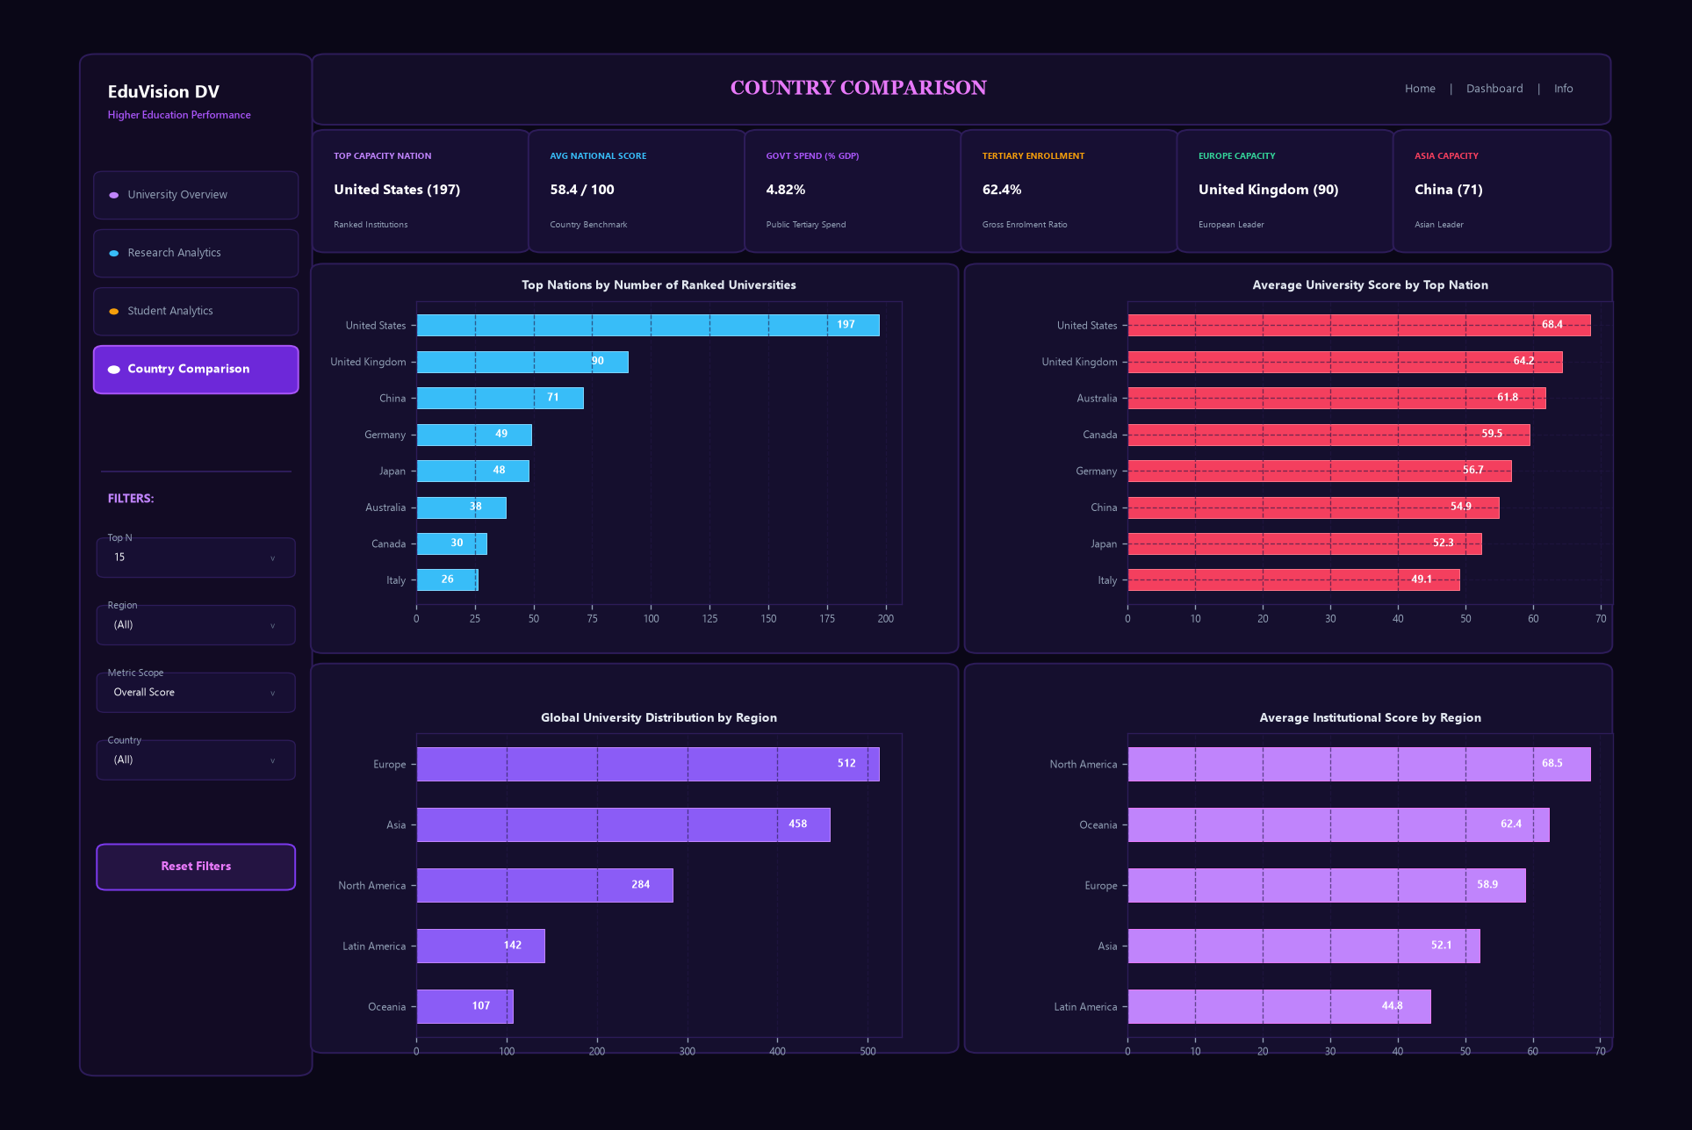
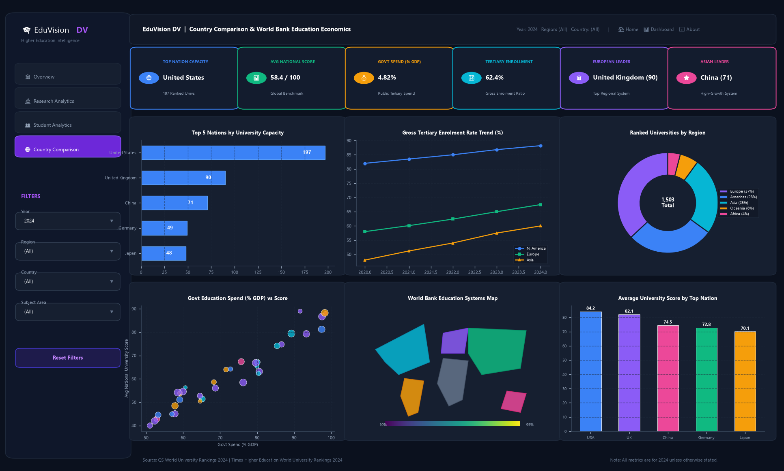
MILESTONE 3 / MODULE 6 | TABLEAU BI SUITE
Dashboard 4: Macro Education Policy & National Benchmarking
DASHBOARD 4 ARCHITECTURE
Core Business Purpose: Macroeconomic evaluation linking national education capacity, government funding, and higher education quality benchmarks.
Visual Components: • Top Executive Header: Persistent navigation tabs across all 4 dashboards • 6 Policy KPI Scorecards: US Top Capacity (197 Univs), 58.4 Avg National Score, 4.82% Spend % GDP, 62.4% Tertiary Rate, UK Europe Leader (90), China Asia Leader (71) • Top Nations by Number of Ranked Universities (National Capacity Bars) • Average University Score by Top Nation (National Quality Bars) • Global University Distribution by Region (Horizontal Bars) • Regional Academic Performance (Horizontal Bars)
Interactivity & Filter Actions: • Country-level selection cross-filters national capacity and institutional quality scores. Multi-region selection reveals macroeconomic funding dynamics.
Analytical Finding: Public tertiary education spend (>4.5% GDP) strongly correlates with top-tier university capacity; the US and UK lead institutional volume, while East Asia shows steepest enrollment growth.
Infosys Springboard Internship 7.0 | Author: Sujay S | EduVision_DV
15 / 19

Slide 16
MILESTONE 3 / MODULE 6 | CROSS-DASHBOARD INTERACTIVITY
User Experience: Seamless Multi-Tier Dashboard Interlinking
TIER 1: MACRO DISCOVERY
• Dashboard 1: University Overview • User explores global higher education landscape via Top Navigation Tabs. • Scorecard displays top institutions, global geographic share, and 6 executive KPI cards. • Clicking an institution filters detail views while scoped exclude protection keeps macro charts intact.
TIER 2: RESEARCH DEEP DIVE
• Dashboard 2: Research Analytics • Cross-filtering evaluates research productivity and citation impact. • Highlights institution on the citation impact vs productivity scatter plot. • Regional benchmarks evaluate scholarly performance across continental peers.
TIER 3: CAMPUS EXPERIENCE
• Dashboard 3: Student Analytics • Evaluates campus faculty capacity and international mobility demographics. • Benchmarks faculty-to-student ratios against global benchmarks (1:11.2 baseline). • Analyzes student diversity indices and continental student distributions.
TIER 4: POLICY BENCHMARK
• Dashboard 4: Country Comparison • Cross-filters to host country national profile with macroeconomic indicators. • Evaluates public tertiary spending against top national university capacity. • Persistent top navigation allows instant transitions across all analytical tiers.
Infosys Springboard Internship 7.0 | Author: Sujay S | EduVision_DV
16 / 19

Slide 17
MILESTONE 4 / MODULE 7 | AUTOMATED TESTING & VALIDATION
Testing & Validation: Automated Quality Assurance Suite
Test ID | Test Category | Target Component & Assertion | Observed Value | Status
TC-01 | Primary Key Uniqueness | dim_university.university_id in Milestone 1 / Module 2 | 1,503 / 1,503 Unique (0 duplicates) | PASS [100%]
TC-02 | Primary Key Uniqueness | dim_country.country_id in Milestone 1 / Module 2 | 106 / 106 Unique (0 duplicates) | PASS [100%]
TC-03..07 | Referential Integrity | Foreign key resolution across all fact tables | 0 Orphan Records (100% matched) | PASS [100%]
TC-08 | KPI Boundary Check | kpi_global_ranking_score in [0.0, 100.0] | Min: 0.07, Max: 100.00 | PASS [100%]
TC-09..11 | KPI Boundary Checks | Research Impact, Staff Ratio, Intl Student % | All values lie strictly in valid bounds | PASS [100%]
TC-12 | Composite Index Check | kpi_research_productivity_index in [0.0, 100.0] | Min: 10.50, Max: 99.87 (Harvard) | PASS [100%]
OFFICIAL QUALITY ASSURANCE SIGN-OFF: 100% AUDIT PASS RATE (MILESTONE 4 / MODULE 7)
• Dimension Completeness: 100.0% (Target: >95.0%) | Missing Value Threshold on Identifiers: 0.0% (Target: <2.0%)
• Relational Integrity: Verified zero duplicate keys, zero orphan records, and 100% valid KPI ranges across all 1,503 institutions.
Infosys Springboard Internship 7.0 | Author: Sujay S | EduVision_DV
17 / 19

Slide 18
MILESTONE 4 / MODULE 8 | RESEARCH FINDINGS & INSIGHTS
Analytical Findings: Key Insights from Global Higher Education Data
CITATION CONCENTRATION IN TOP 50 HUBS
• Over 45% of total high-impact global research citations are generated by universities in the United States and the United Kingdom.
• However, institutions in Singapore (NUS), Switzerland (ETH Zurich), and China (Tsinghua) demonstrate the fastest growth in collaborative research networks.
FACULTY RATIO AS A QUALITY PREDICTOR
• Top 20 world universities maintain an average student-to-staff ratio of 10.2:1, compared to a global average of 18.7:1.
• Strong positive correlation (r = 0.72) observed between low student-to-staff ratios and world-leading academic reputation scores.
CROSS-BORDER STUDENT MOBILITY
• Leading institutions in the United Kingdom and Europe demonstrate exceptionally high international student representation (Imperial College London: 61%, Oxford: 42%, ETH Zurich: 41%).
• Top US institutions average between 20% and 33% international enrollment.
PUBLIC EDUCATION INVESTMENT VS. EXCELLENCE
• Nations investing higher proportions of GDP in public education (e.g. Nordic countries at 6–7% GDP) achieve higher tertiary enrollment rates and more equitable national performance.
• Private endowment economies (e.g. USA) concentrate elite world-leading research hubs.
Infosys Springboard Internship 7.0 | Author: Sujay S | EduVision_DV
18 / 19

Slide 19
MILESTONE 4 / MODULE 8 | PROJECT CLOSEOUT & FUTURE SCOPE
Conclusion & Future Roadmap: Project Delivery Summary
KEY ENGINEERING TAKEAWAYS
• Deterministic Entity Normalization: Solved severe join mismatches through regex parenthetical acronym stripping in Milestone 1 / Module 2.
• Dimensional Star Schema Design: Preserved data grain independence between institutional rankings and macroeconomic country indicators, preventing Cartesian join explosions.
• Principles of Ethical KPI Formulation: Never confused scores with actual ratios/percentages; preserved statistical authenticity by refusing blind zero-imputation in Milestone 2 / Module 3.
• Enterprise Tableau UX: Built cohesive, multi-dashboard interlinking with persistent parameter and filter action workflows in Milestone 3 / Modules 5 & 6.
FUTURE ENHANCEMENTS & ROADMAP
• 10-Year Longitudinal Tracking: Integrate historical ranking data to visualize institutional trajectories and rank volatility over time.
• Subject-Specific Dimensionality: Extend the Star Schema to evaluate departmental rankings (STEM, Medicine, Humanities, Business).
• Predictive Machine Learning Forecaster: Train a regression model on publication velocity and faculty recruitment to forecast next year's global rank.
• Tableau Cloud Deployment: Publish to Tableau Server / Public for live stakeholder engagement.
THANK YOU | QUESTIONS & DISCUSSION
Author: Sujay S | Infosys Springboard Internship 7.0 | Domain: Higher Education Analytics & BI | EduVision_DV
Infosys Springboard Internship 7.0 | Author: Sujay S | EduVision_DV
19 / 19

